Slide 1
Universal BioCoin
Guo-Bo Chen

Slide 2
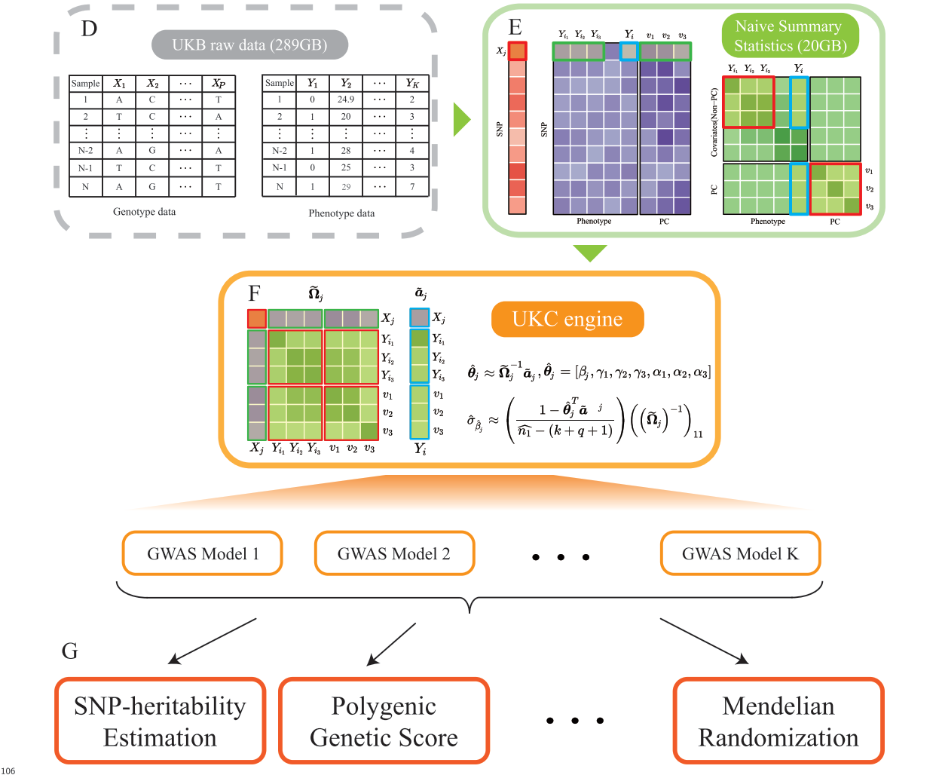
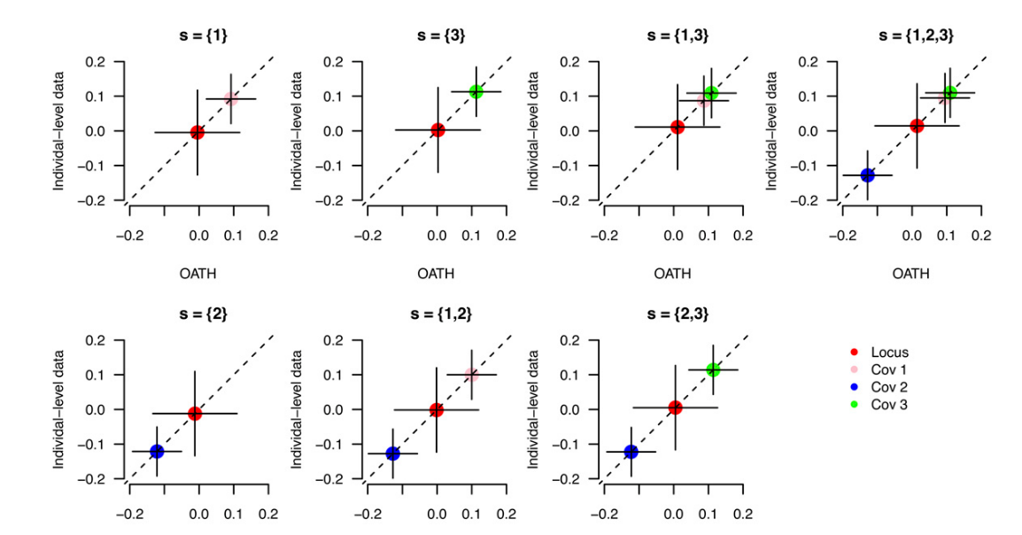
https://github.com/gc5k/OATH/tree/master/DemonFig2
https://github.com/Ttttt47/UKBioCoin

Slide 3
Missing data

Slide 4
Missing data

Slide 5
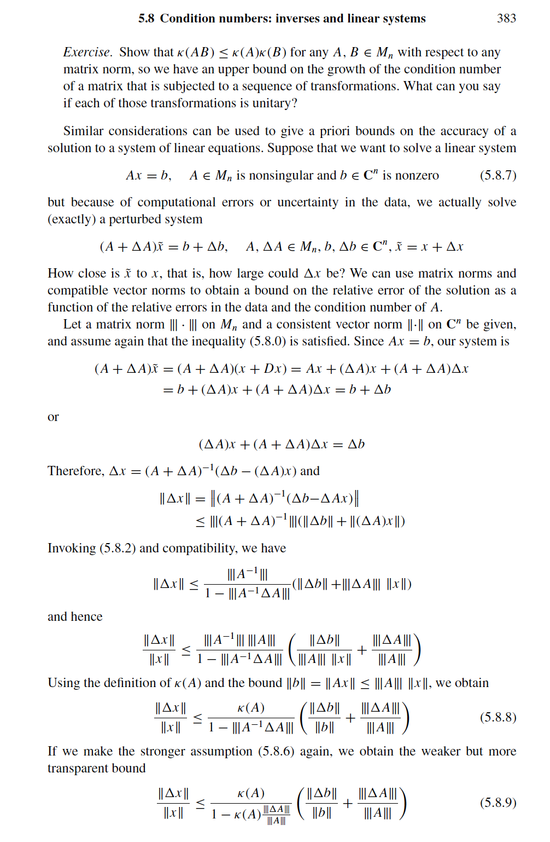

Slide 6
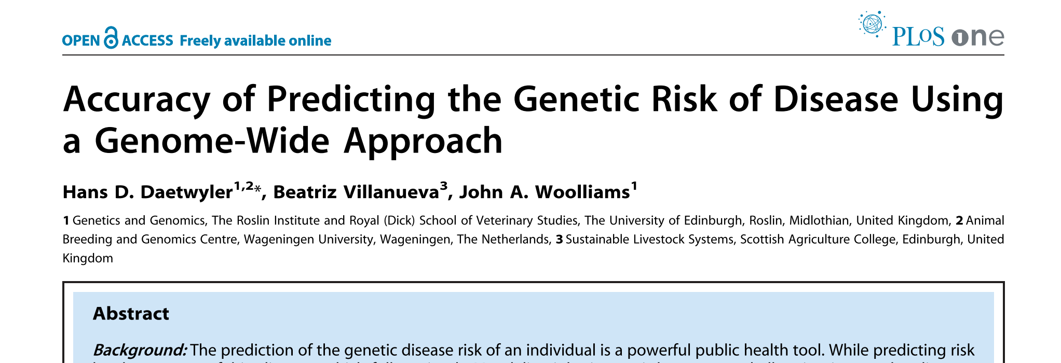

Trinity
Y
X

Slide 7
UBC Architecture
A
O
B
L0
C
D
L1
数据“UBC”化
A | B | C | D | E
F | G | H | I | J
K | L | M | N | O
L2
L3
API 1
API 2
API 3
API x

Slide 8
UBC Architecture for UK Biobank
Cohort | Sample size
Edinburgh | 16,674
Glasgow | 18,287
Newcastle | 36,224
Middlesbrough | 20,757
Leeds | 43,421
Sheffield | 29,531
Bury | 27,957
Manchester | 13,799
Liverpool | 32,031
Stoke | 19,131
Nottingham | 33,386
Birmingham | 24,510
Cardiff | 17,666
Bristol | 42,290
Oxford | 13,911
Reading | 29,114
Hounslow | 27,664
Croydon | 26,412
Barts | 12,393
Oxford
Barts
Manchester
L0
Glasgow
Liverpool
L1
数据“UBC”化
A | B | C | D | E
F | G | H | I | J
K | L | M | N | O
L2
L3
API 1
API 2
API 3
API x
测试阶段只需要浙大内网的服务器

Slide 9
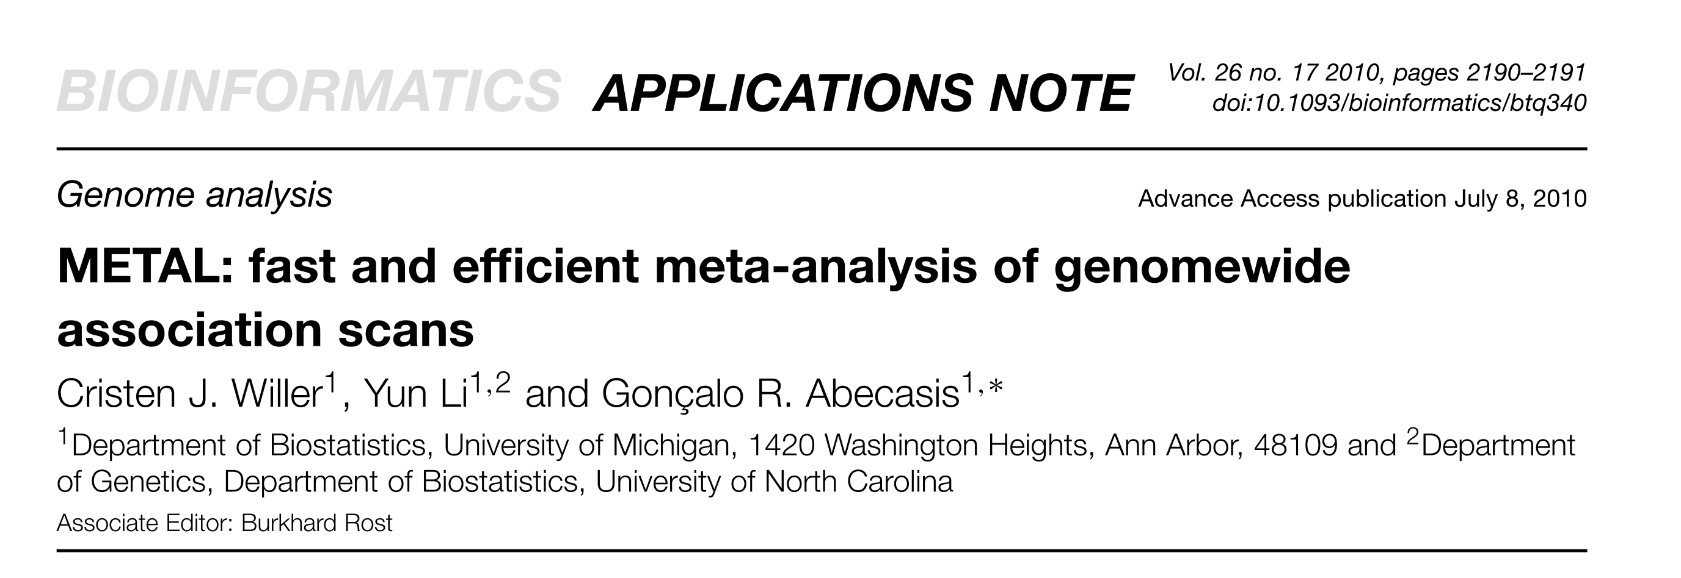
UBC NIPT Consortia
HE实现的比较
Baoan
Longgang
L0
WZ
L1
数据“UBC”化
A | B | C | D | E
F | G | H | I | J
K | L | M | N | O
L2
L3
API 1
API 2
API 3
API x
需要外网（阿里云）服务器

Slide 10
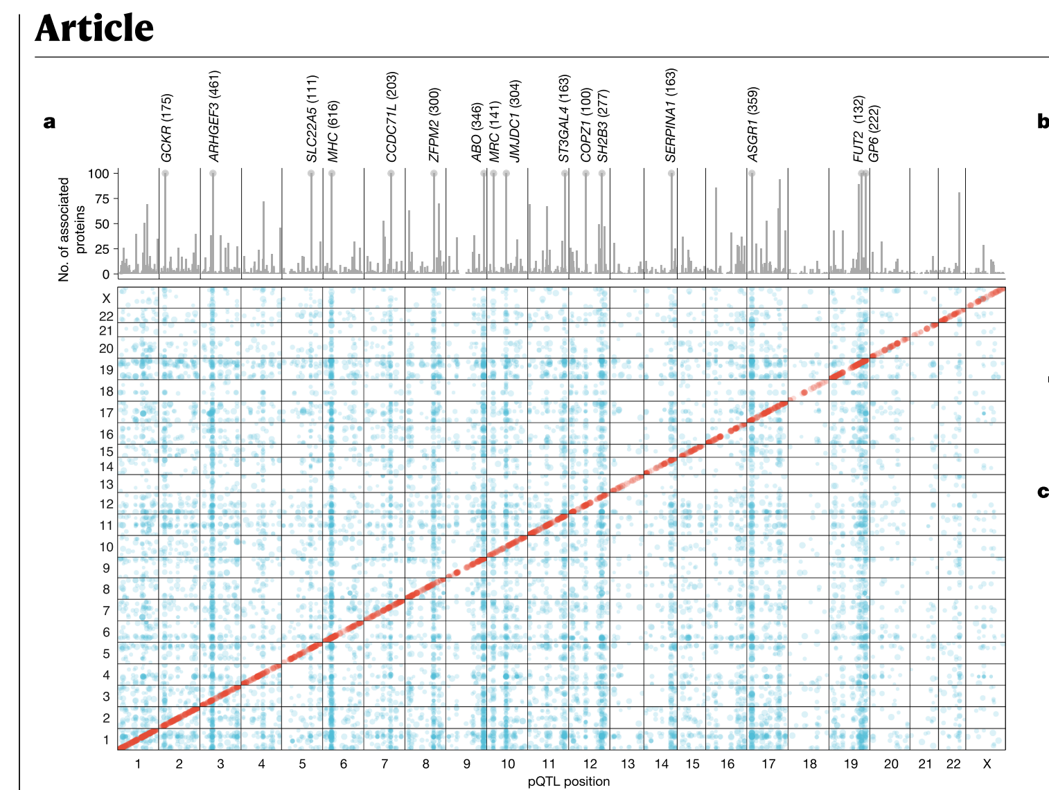
UKBioCoinPro

